Slide 1

Parallel Algorithms for Butterfly Computations
Research Paper by Jessica Shi & Julian Shun
Presentation by:
Mishal Ali 22i-1291
Hassaan Anwar 22i-0890
Atif Ibrahim 22i-1249

Slide 2
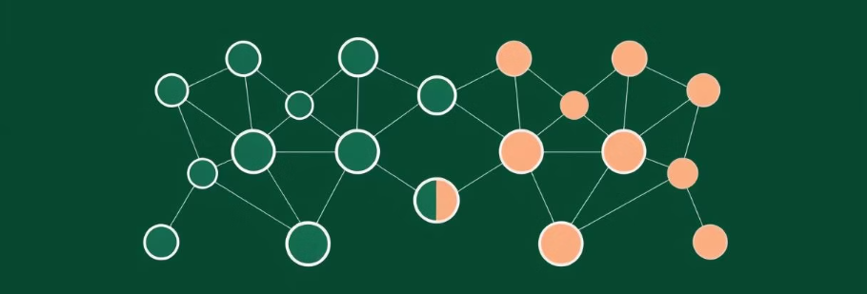
Motivation & Background
Bipartite Graphs
Why Butterflies?
Recommendation Systems → Users and items form two sets — edges represent interactions
Smallest substructure of bipartite graph
Analogous to Triangles →In unipartite graphs, indicate tight-knit groups, while in bipartite, capture local density and connectivity.
Peer-to-Peer Networks → Peers and shared resources (files) can be modeled as bipartite.
Biological Networks →Like genes and diseases, where connections indicate known associations.
Spam / Fraud detection → Unnatural bursts indicate bot behavior or collusion
Simple structure → no odd length cycles, making them easier to analyze
Graph Mining & clustering → Counting butterflies helps in clustering nodes or identifying important hubs

Slide 3
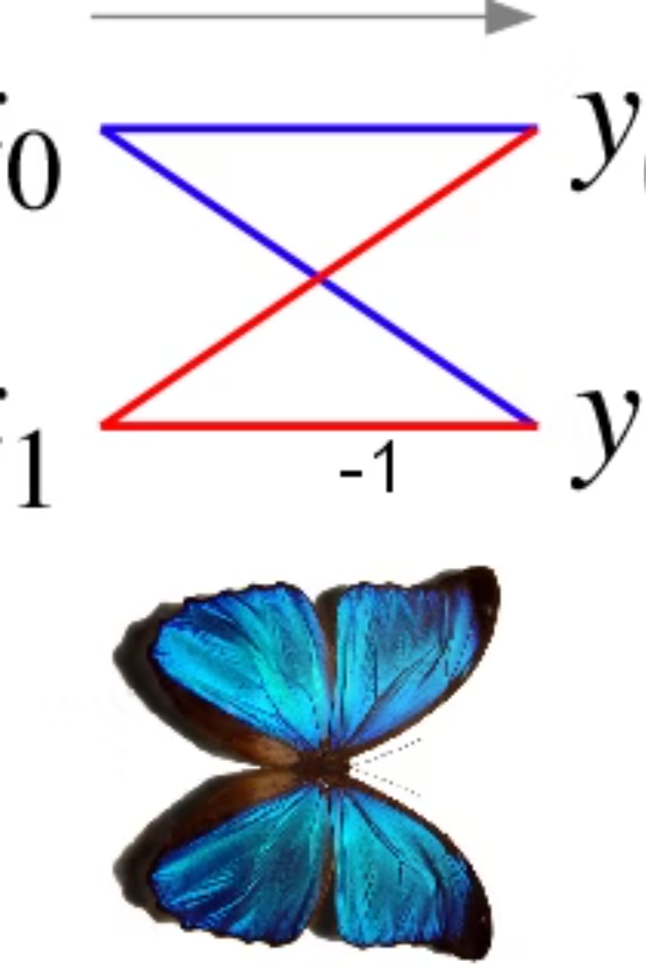
What is a Butterfly?
(2,2)-Biclique
A butterfly is a (2,2)-biclique.
It has two vertices on each side.
All four edges connect them.
Wedge (2-path)
A wedge is a building block.
It is a 2-path in the bipartite graph.
Butterflies are formed from combinations of wedges.

Slide 4
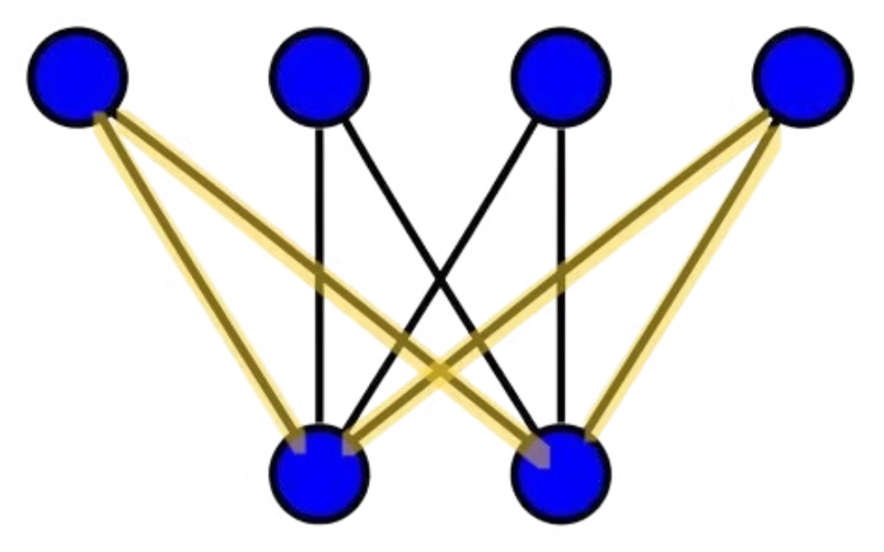
Butterfly highlighted in a bipartite graph

Slide 5




Key Contributions:
PARBUTTERFLY
A parallel butterfly computation framework.
Vertex ranking → Wedge generation → Aggregation → Counting
Parallel Algorithms
Butterfly counting →global, per-vertex, & per-edge methods.
Wedge Aggregation → sorting, hashing, histogramming & batching
Vertex ranking strategies → degree, side order & degeneracy
Decomposition Methods
Tip decomposition → vertex peeling
Wing decomposition → edge peeling
Theoretical Analysis
Work complexity → O(αm)
Span → O(log m)
Speedup → · 38.5× over themselves & 13.6× over sequential baselines

Slide 6
Overview of PARBUTTERFLY Framework
1. Vertex Ranking
Assigns a global order to vertices to reduce wedge enumeration and improve efficiency.
2. Wedge Generation
A wedge is a 2-path (like (u1, v, u2)).
Enumerate all valid wedges in the graph (following the rank constraints).
3. Aggregation
Group wedges by their endpoints to count how many form a butterfly.
4. Counting
Use wedge counts to compute: Global, Per-Vertex, Per-edge counts

Slide 7
Parallel Techniques in PARBUTTERFLY
Wedge Aggregation Methods
Sorting:
Organize wedges by endpoints using parallel sample sort
Hashing:
Parallel hash tables with atomic additions
Faster on graphs with many duplicate wedges
Histogramming:
Counts wedge frequencies using hash + sort hybrid
Balances performance and memory
Batching:
Simple or wedge-aware batching strategies
Best real-world performance due to lower overhead

Slide 8
Continuation…
Parallel Primitives
Approximate Counting
Core Parallel Primitives Used
Approximate Counting with Graph Sparsification
Prefix Sum: Efficient indexing of wedge positions
Subsample edges from the original bipartite graph
Semisort: Group items without full sort (faster, relaxed)
Count butterflies in the smaller graph
Scale results to estimate original count
Filter: Select wedges matching rank constraints
Used for total butterfly count only
Based on Sanei-Mehri et al.'s approach

Slide 9
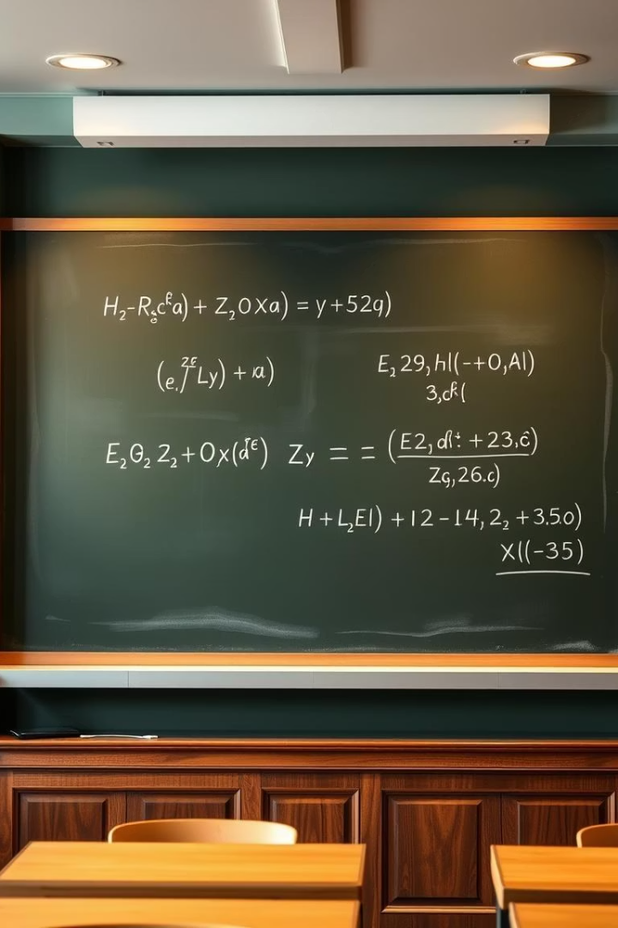



Theoretical Bounds
Work Bounds
Span Bounds
Empirical Performance
The paper establishes theoretical work and span bounds. It shows strong empirical performance of the proposed algorithms on real-world datasets.

Slide 10
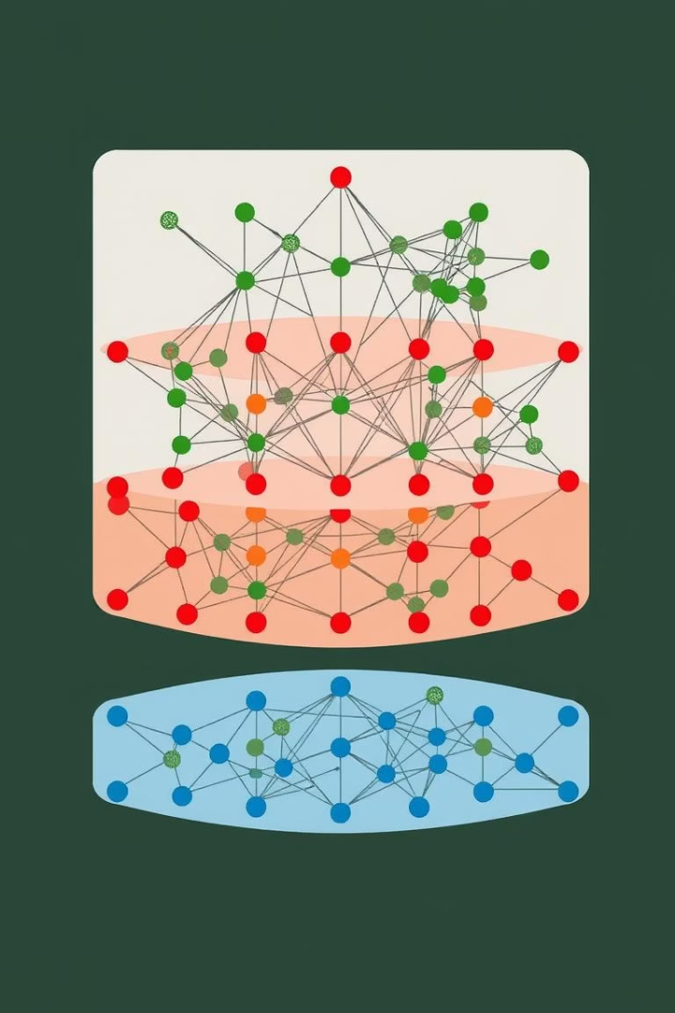



Tip Decomposition (Vertex Peeling)
Identify Tips
Find vertices with low butterfly counts.
Peel Vertices
Remove these vertices from the graph.
Iterate
Repeat until the graph is empty.

Slide 11
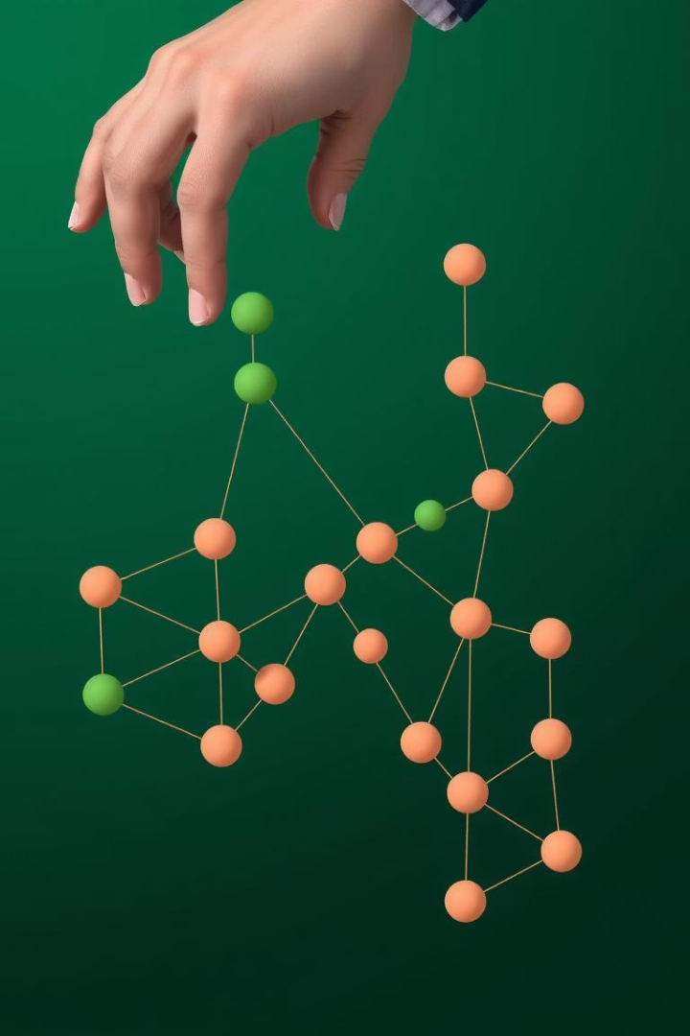



Wing Decomposition (Edge Peeling)
Edge Selection
Choose edges with low butterfly counts.
Edge Removal
Remove these edges from the graph.
Repeat Process
Continue until the graph has no edges.

Slide 12
Peeling with Tip and Wing Decomposition
k-tip and k-wing: Identify vertices or edges with at least k butterflies participation.
Parallel methods: Use parallel bucketing and Fibonacci heap for efficient peeling.
Iterative peeling: Remove low-count vertices/edges, update counts, repeat until stable.
Applications: Finds dense communities, reveals hierarchy, and filters noise in graphs.

Slide 13
Algorithm Process and Applications
Algorithm Process
Applications
Compute butterfly counts for all vertices and edges initially
Detects densely connected communities in bipartite networks
Remove vertices/edges with lowest counts iteratively
Reveals hierarchical connection structures
Update butterfly counts affected by removals
Filters noise in complex real-world graphs
Repeat until no vertices/edges fall below threshold

Slide 14
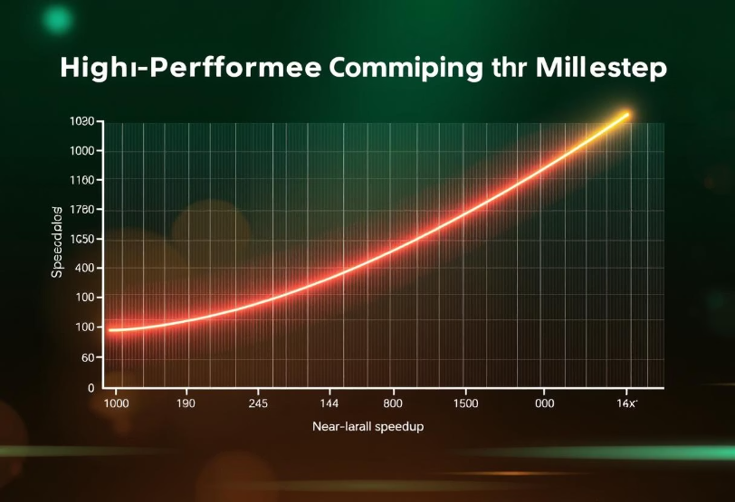
Performance & Results
Up to 38.5× speedup on a 48-core machine
13.6× faster than the fastest sequential baseline
Orders of magnitude faster than PGD, a general subgraph counter

Slide 15

Parallelization Strategy Proposal
Hybrid Parallel Approach
MPI: Inter-node distributed memory parallelism
OpenMP/OpenCL: Intra-node shared memory or GPU parallelism
METIS: Graph partitioning for load balancing
Implementation Steps
Partition graph using METIS to minimize communication
Distribute subgraphs to MPI processes across cluster
Local nodes run OpenMP/OpenCL for wedge generation and counting
Synchronize and combine counts using MPI Allreduce
Gather global statistics and final results

Slide 16
Thank You!
Any Questions?

